Slide 1
Automated Video Interviews Analysis
By:
Arsany Atef Abdo - Toka Alaa
Jamal El Din Ahmed - Hazem Morsy
Nada Salama - Yomna Gamal El Din
Supervised By: Dr. Marwan Torki - Dr. Hicham Elmongui

Slide 2
Agenda
What is Automated Video Interview Analysis?
Why Automated Video Interview Analysis?
System requirements
Dataset - MIT Interview
System Modules
Combining Models
Application Demo
Future work
References

Slide 3
What is Automated Video Interview Analysis ?

Slide 4
What is Automated Video Interview Analysis ?
Automatic analysis of video interviews to recognize individual personality by three modalities:
Facial Expressions
Body Language
Hand Gestures
Hand Over Face
Speech

Slide 5
Why Automated Video Interview Analysis ?

Slide 6
Why automated video Interview analysis ?
For the market: The COVID-19 pandemic caused many businesses to lay off and put hiring on pause. The number one challenge companies will face as they look to restart hiring is that their people and financial resources may be dramatically limited.
Motivation as scientific problem: Analysis of non-verbal behavior to predict the outcome of a social interaction has been studied for many years in different domains but most of them are focused on a single modality but in job interview domain the challenge is automated understanding of multimodal human interactions.

Slide 7
System requirements

Slide 8
System requirements
User must use a laptop, PC or tablet camera.
The upper part of body “and hand” for the user must appear clearly in the video.
User voice must be high and clear.
User must adjust his video brightness to be clear.

Slide 9
MIT Interview Dataset

Slide 10
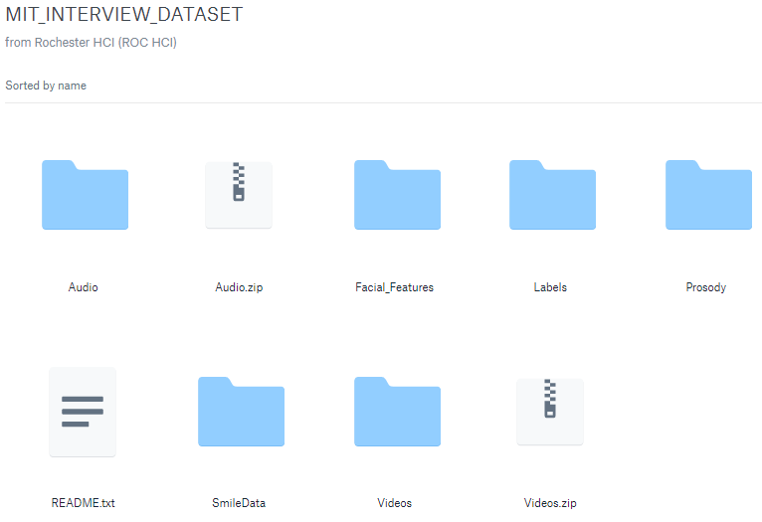
MIT Interview Dataset
Automated Analysis and Prediction of Job Interview Performance paper [1] which uses the MIT Interview Dataset and we compare our work to the results in this paper.
MIT Interview Dataset is containing the audio-visual recordings of 138 job interviews, conducted by professional career counselors with 69 undergraduate MIT students.
We used 80% of the videos for training and the rest were used for testing.

Slide 11
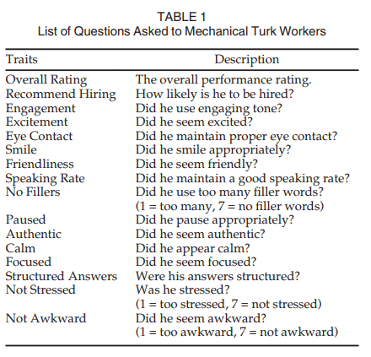
Data Labeling
for each of the videos, there exist Amazon Mechanical Turk ratings, the final ground truth ratings, and the processed feature values.
We have 16 labels of 16 different traits.

Slide 12
The Interview Procedure
During each interview session, the counselor asked interviewees five different questions, which were recommended by the MIT Career Services. These five questions were presented in the following order by the counselors to the participants:
Q1. So please tell me about yourself.
Q2. Tell me about a time when you demonstrated leadership
Q3. Tell me about a time when you were working with a team and faced a challenge. How did you overcome the problem?
Q4. What is one of your weaknesses and how do you plan to overcome it?
Q5. Now, why do you think we should hire you?

Slide 13
Facial Expressions

Slide 14
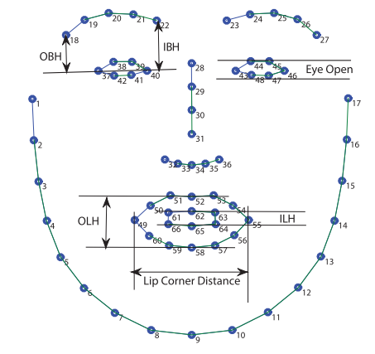
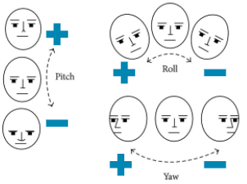
12 facial features
They are as following:
Pitch
Roll
Left Outer Eyebrow (otBrL)
Right Outer Eyebrow (otBrR)
Right Outer Eye (EyeOR)
Inner Lip Height (iLipH)
Lip Corner Distance (LipCDt).
Yaw
Left Inner Eyebrow (inBrL)
Right Inner Eyebrow (inBrR)
Left Outer Eye (EyeOL)
Outer Lip Height (oLipH)

Slide 15
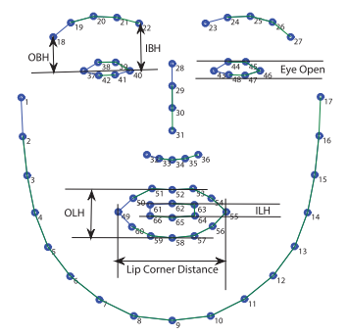
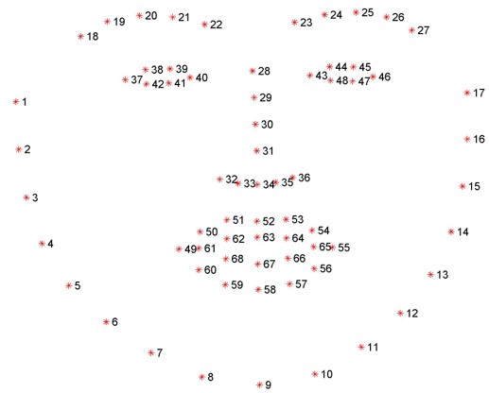
Detect facial landmarks using DLIB and OpenCV
With OpenFace (66 points)
With OpenCV and DLIB (68 points)

Slide 16
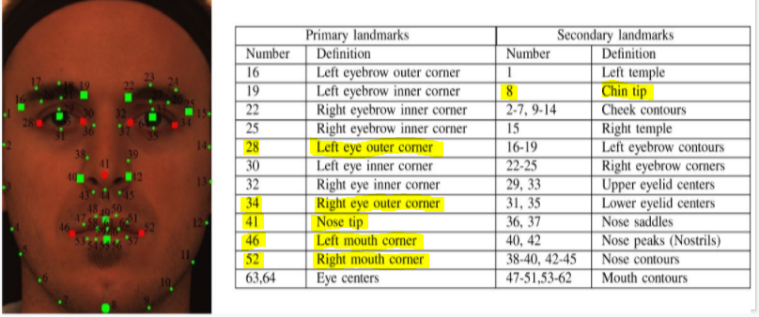
Extract (pitch, yaw, roll) features

Slide 17
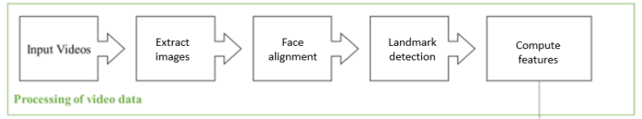
Data Pre-processing

Slide 18
Facial Model Training
No. Of extracted facial features per question = 12
No. of asked questions = 5
Total input : 12 * 5 = 60 features
Train a Support Vector Regression (SVR) model for each label of the 16 traits.
For each of the traits, we will use exactly the same set of features. The model automatically learned the weights for individual features for each trait.
Evaluation metric: correlation coefficient
sklearn.svm.SVR
Exhaustive Grid Search : GridSearchCV

Slide 19
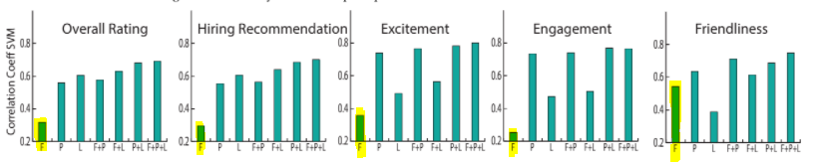
Facial Model Results
A figure shows Correlation Coefficients for SVM, for different combinations of facial (F), prosodic (P), and lexical (L) features.
The figure is taken from paper “Automated Analysis and Prediction of Job Interview Performance”.
Overall | Hiring | Excited | Engagement Tone | Friendly
train: 0.994 test: 0.573 | train: 0.995 test: 0.460 | train: 0.996 test: 0.054 | train: 0.996 test: 0.086 | train: 0.995 test: 0.562

Slide 20
Hand Gestures

Slide 21
Body Language Tips for Interview
Keep your body open.
Lean forward from the waist.
Slow your breathing down.
Use a steady hand gesture to emphasize a point.
Use hand movement or positive gestures.
Palm upwards signifies honest and trustworthiness.
Avoid clasping hands and clenching fists as they reflect anxiety.
Avoid touching your face “signal of lying”.
Wild hand or arm movements are not good, it reflects that you are nervous and unpredictable.
Do not cross your arms, as it shows disrespect and could add negative impressions to the interviewer.

Slide 22
Hand Gestures
Get Hand Landmarks:
MediaPipe hand landmark model performs precise keypoint localization of 21 - 3D hand-knuckle coordinates inside the detected hand regions via regression, that is direct coordinate prediction. The model learns a consistent internal hand pose representation and is robust even to partially visible hands and self-occlusions.
It’s very fast according to any other methods as openpose, AlphaPose, RCNN, etc..., Its speed on an example from the MIT dataset:
2:15 is the time needed to get data from a video of length = 3:17.
Also, it is suitable for our problem, it gets only hand points without a load of other body points.

Slide 23

MediaPipe Hand Landmarks

Slide 24
Hand Gestures
DataSet:
Using MIT dataset after labeling videos in, labels are (Rest - Move - Clasped hand - Crossed arm). The result was 57 videos had labels, and the rest of 138 videos hands did not appear clearly in them.
Approach:
Using the idea used in ‘gesture unit segmentation using support vector machines’ paper [2] but with some changes. It used the shoulder and wrist points and calculating their displacement and acceleration as input of the SVM model. Since the analysis of results in the paper proves that using hand ‘wrist’ points only has results better than using shoulders and using only past time displacement gives better results, we decide to work on all hand-points we could get and use only past time displacement.

Slide 25
Hand Gestures
Steps:
Using MediaPipe Hands to get points of both hands.
Calculate velocity and acceleration for wrist only by using only past time displacement.
Using Cluster centroids to balance data and standard scaler to normalize it.
Using PCA reduces features from 134 to 10.
Applying Grid Search on SVC to get the best parameters.
Train the model
The result of a video is an array containing labels for each frame. Then we get the ratio of each class and also the ratio of undetected hands frames.
Labels are (Rest - Move - Clasped hand - Crossed arm).

Slide 26
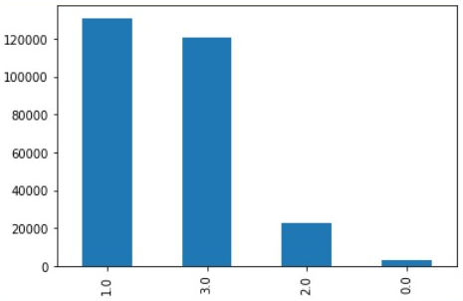
Evaluation
Train Accuracy: 94.8% Test Accuracy: 69.69%
It is clear that this model needs more data to train on, as before balancing data number of frames were 277059 frames, and after balancing, they became 12420 frames only.
There is no other available dataset for this part that we can use, so the future work for this part is to train with a larger dataset and have a variety of classes also.

Slide 27
Hand Over Face

Slide 28
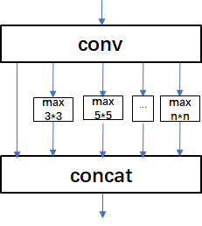
Hand Over Face
A CNN model for object detection is used called Yolov3-spp. The idea is taken from keras creator’s tweet Francois Chollet.
The spatial pyramid pooling unit(SPP) in the model helps in:
Effectively avoid the problems of image distortion caused by cropping and zooming the image area.
The problem of repeated feature extraction of the image by the convolutional neural network is solved, the speed of generating candidate frames is greatly improved, and the calculation cost is saved.

Slide 29
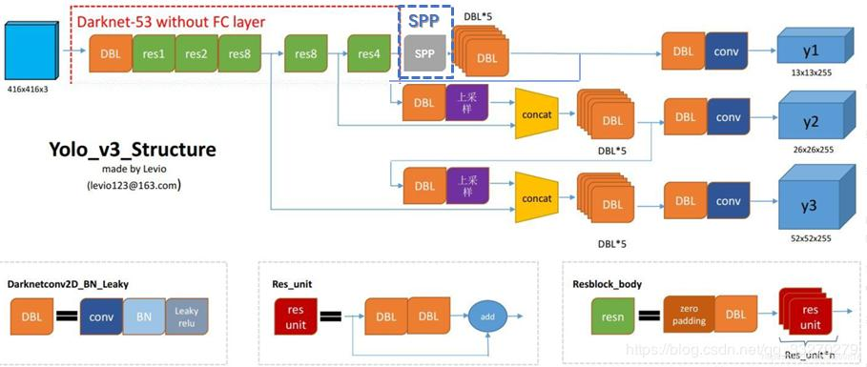
Hand Over Face

Slide 30
Hand Over Face
Facetouch Dataset:
It contains 1040 images splitted into 75% train, 15% validation and 10% test.
The labels are in Yolo format <object-class> <x> <y> <width> <height> where object-class is the class number, x&y are the center of the bounding box that contains the object, width is width of the bounding box and height is the height of the bounding box. x,y,width and height are normalized between 0&1.
Result:
mAP at Iou 0.5 = 47.1 for facetouch but the model for object detection originally gets mAP at IoU 0.5 = 64.6

Slide 31
Speech Emotion Recognition

Slide 32
Speech Emotion Recognition
We need to extract features from the speech of people. The most popular way for feature extraction techniques is the MFCC [3].
After that we need to extract Delta features, Delta of Deltas features, and the logbank filters that extract 40 features from each frame which helps in training with the models [4].
Speech Input
Pre- Emphasis
Fram
ing
Window
ing
FFT
Mel Filter bank
Discrete cosine transform
Delta Energy
Output
MFCC block diagram [3]

Slide 33
Speech Emotion Recognition
Feature Extraction
Using PythonSpeechFeatures library
This approach helps us to get the MFCC, Delta, Delta of Deltas features in the simplest and easiest way as it just needs a few lines of codes without much calculation to get the features we need to be used in training the model of the Speech Emotion Recognition.

Slide 34
Speech Emotion Recognition
Training Model
Using SVR model
The model implemented to be used in training the dataset of MIT is SVR model with some preprocessing like scaling the data and with some parameter tuning using GridSearchCV.

Slide 35
Speech Emotion Recognition
Steps
Split all audios to 5 parts for each audio interview each one containing one answer for one question. So, we have 138 × 5 = 690 audios.
For each audio we read the wave signal and get its sequence and sampling rate.
Extract MFCC using log bank filters from the PythonSpeechFeatures.
Extract Delta using derivative of MFCC and Delta of Deltas using derivative of Delta features.
Stack all the extracted features together into a frame, get the mean of that frame.
Get the average of each 5 audios to have the preprocessed data that have all features extracted from each interview audio.

Slide 36
Speech Emotion Recognition
Steps cont.
Normalize using a min-max scaler. Tune using GridSearchCV.
Train with the SVR model from SVM and get the correlation using Pearson for each trait for AGGR labels.
40: features extracted from each interview, and 3: log_mel, Delta, and Delta of Deltas. So, there are 120 features for each interview audio.
So, the model has input features and outputs the correlation value for each trait of the labels from the MIT dataset.

Slide 37
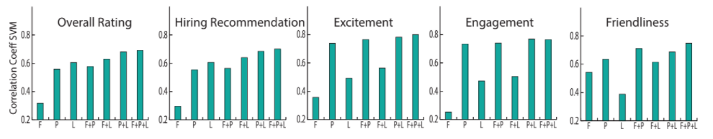
Speech Emotion Recognition
Evaluation
We use evaluation matrix correlation then we compare our result with the paper's results.
Overall | Hiring | Excited | Engagement Tone | Friendly
train: 0.719 test: 0.376 | train: 0.701 test: 0.607 | train: 0.804 test: 0.782 | train: 0.811 test: 0.652 | train: 0.715 test: 0.522

Slide 38
Combining Models

Slide 39
Combining Facial and Sound
the sound module is 120 features and the facial module is 60 features for each video
We combine sound and facial modules in four ways:
Combining the two groups of features (180 features) then entering them into the SVR model.
Combining the result of each SVR model of each module then entering it into the Linear Regression model.
Combining the result of each SVR model of each module then applying simple averaging .
Combining the result of each SVR model of each module then applying weighted averaging .
Then we compare our results each way and take the best test score.

Slide 40
 | Overall | Hiring | Excited | Friendly | Engagement Tone | Colleague | Engaged
Facial | train: 0.994 test: 0.573 | train: 0.995 test: 0.460 | train: 0.996 test: 0.054 | train: 0.995 test: 0.562 | train: 0.996 test: 0.086 | train: 0.992 test: 0.448 | train: 0.993 test: 0.189
Sound | train: 0.719 test: 0.376 | train: 0.701 test: 0.607 | train: 0.804 test: 0.782 | train: 0.715 test: 0.522 | train: 0.811 test: 0.652 | train: 0.704 test: 0.610 | train: 0.727 test: 0.614
linear Regression | train: 0.994 test: 0.583 | train: 0.995 test: 0.476 | train: 0.996 test: 0.080 | train: 0.995 test: 0.573 | train: 0.997 test: 0.100 | train: 0.992 test: 0.473 | train: 0.993 test: 0.210
feature | train: 0.938 test: 0.563 | train: 0.922 test: 0.619 | train: 0.994 test: 0.581 | train: 0.978 test: 0.723 | train: 0.960 test: 0.589 | train: 0.514 test: 0.657 | train: 0.992 test: 0.497
Simple averaging | train: 0.954 test: 0.696 | train: 0.956 test: 0.734 | train: 0.963 test: 0.590 | train: 0.960 test: 0.714 | train: 0.961 test: 0.464 | train: 0.951 test: 0.696 | train: 0.955 test: 0.554
Weighted averaging | train: 0.845 test: 0.563 | train: 0.843 test: 0.735 | train: 0.887 test: 0.794 | train: 0.853 test: 0.701 | train: 0.886 test: 0.674 | train: 0.837 test: 0.703 | train: 0.852 test: 0.666
Notes:
overall = 0
recommend hiring = 1
excited = 3
engaged = 4
friendliness = 7

Slide 41
 | EyeContact | Smiled | Speaking Rate | NoFillers | Paused | Structured Answers | Calm
Facial | train: 0.872 test: 0.411 | train: 0.850 test: 0.571 | train: 0.947 test: -0.008 | train: 0.836 test: -0.058 | train: 0.876 test: 0.113 | train: 0.994 test: 0.379 | train: 0.720 test: -0.139
Sound | train: 0.477 test: 0.447 | train: 0.683 test: 0.545 | train: 0.632 test: 0.753 | train: 0.815 test: 0.715 | train: 0.643 test: 0.752 | train: 0.681 test: 0.649 | train: 0.642 test: 0.482
linear Regression | train: 0.873 test: 0.431 | train: 0.871 test: 0.656 | train: 0.951 test: 0.065 | train: 0.890 test: 0.642 | train: 0.883 test: 0.359 | train: 0.995 test: 0.400 | train: 0.783 test: 0.045
Feature | train: 0.848 test: 0.424 | train: 0.631 test: 0.471 | train: 0.946 test: 0.112 | train: 0.966 test: -0.042 | train: 0.858 test: 0.179 | train: 0.990 test: 0.423 | train: 0.990 test: 0.170
Simple averaging | train: 0.832 test: 0.562 | train: 0.860 test: 0.682 | train: 0.911 test: 0.345 | train: 0.887 test: 0.688 | train: 0.863 test: 0.644 | train: 0.976 test: 0.543 | train: 0.778 test: -0.019
Weighted averaging | train: 0.677 test: 0.577 | train: 0.781 test: 0.634 | train: 0.776 test: 0.666 | train: 0.852 test: 0.719 | train: 0.767 test: 0.751 | train: 0.882 test: 0.639 | train: 0.759 test: 0.233
Notes:
overall = 0
recommend hiring = 1
excited = 3
engaged = 4
friendliness = 7

Slide 42
 | Not Stressed | Focused | Authentic | Not Awkward
Facial | train: 0.988 test: 0.119 | train: 0.989 test: 0.458 | train: 0.922 test: 0.361 | train: 0.995 test: 0.472
Sound | train: 0.575 test: 0.604 | train: 0.679 test: 0.598 | train: 0.774 test: 0.433 | train: 0.665 test: 0.409
linear Regression | train: 0.989 test: 0.152 | train: 0.989 test: 0.480 | train: 0.934 test: 0.466 | train: 0.995 test: 0.484
feature | train: 0.666 test: 0.130 | train: 0.988 test: 0.449 | train: 0.441 test: 0.113 | train: 0.995 test: 0.607
Simple averaging | train: 0.968 test: 0.403 | train: 0.965 test: 0.611 | train: 0.923 test: 0.531 | train: 0.955 test: 0.661
Weighted averaging | train: 0.849 test: 0.586 | train: 0.860 test: 0.656 | train: 0.857 test: 0.505 | train: 0.830 test: 0.570
Notes:
overall = 0
recommend hiring = 1
excited = 3
engaged = 4
friendliness = 7

Slide 43
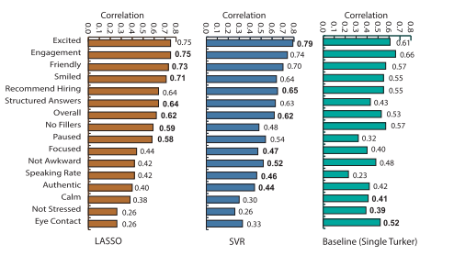
Comparing between our result and paper’s result

Slide 44
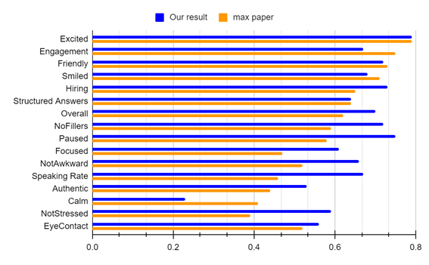
Comparing between our result and paper’s result cont.

Slide 45
Comparing between our result and paper’s result cont.
 | Excited | Engagement | Friendly | Smiled | Hiring | Structured Answers | Overall | No Fillers
Our Result | 0.79 | 0.67 | 0.72 | 0.68 | 0.73 | 0.64 | 0.7 | 0.72
Max paper | 0.79 | 0.75 | 0.73 | 0.71 | 0.65 | 0.64 | 0.62 | 0.59
 | Paused | Focused | Not Awkward | Speaking Rate | Authentic | Calm | Not Stressed | Eye- Contact
Our Result | 0.75 | 0.61 | 0.66 | 0.67 | 0.53 | 0.23 | 0.59 | 0.56
Max paper | 0.58 | 0.47 | 0.52 | 0.46 | 0.44 | 0.41 | 0.39 | 0.52

Slide 46
Application Demo

Slide 47
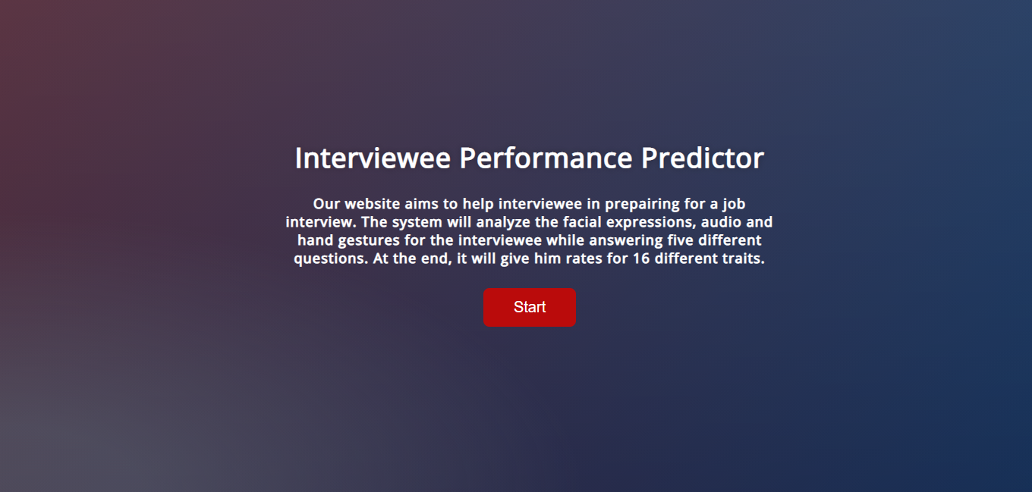

Slide 48
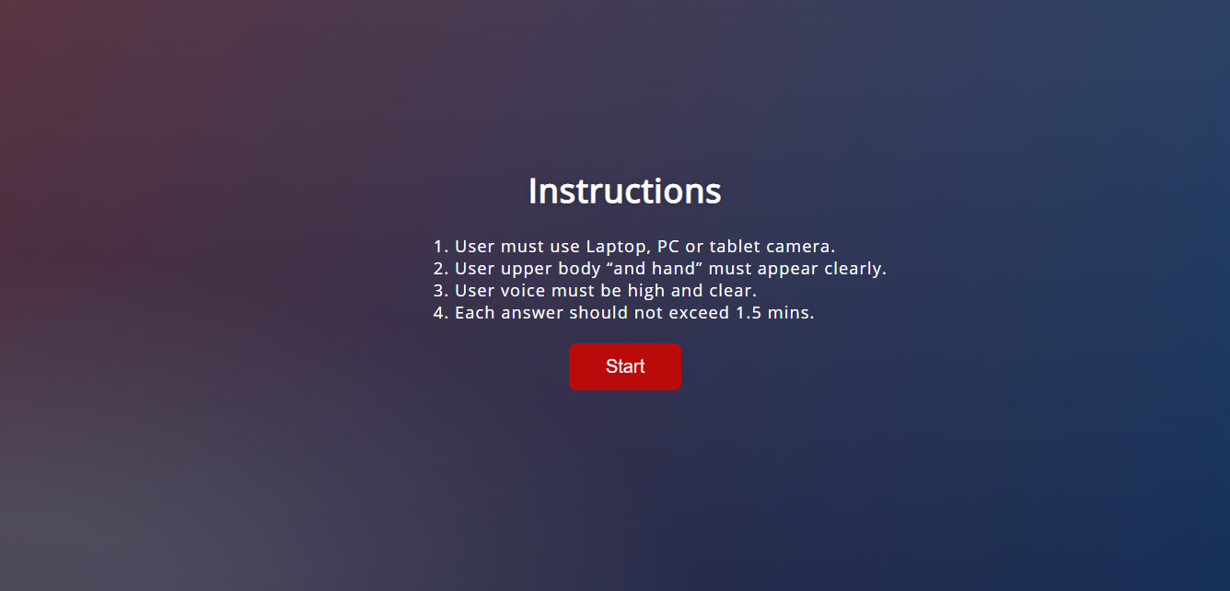

Slide 49


Slide 50
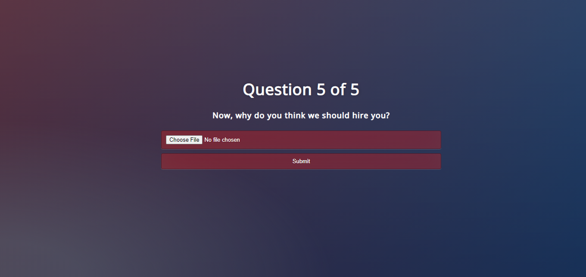

Slide 51
Future work

Slide 52
Future work
Try to improve the application user interface, add input validation and ensure the user that his data is not going to be used for blackmailing or cyberbullying.
We can speed up the system processing step by modifying some models, for example using the YOLO in detecting the facial features as it was good in the hand-over-face part.
For the hand gesture model, train with a larger dataset and have a variety of classes as there is no good dataset available for this part.

Slide 53
Future work
Add another feature in the application by using GAN models to improve the user experience as the user not only can know his mistakes but also know how to fix them by seeing a video of himself without his mistakes.
We can improve the results by adding a lexical module that uses a speech recognition model to produce transcripts which helps in the analysis of the interview.
Try to make a new dataset like MIT videos that have the same concept, but the point of view will be better when it is in front of the interviewer, and the upper half of the body appears clearly.

Slide 54
References

Slide 55
References
Naim, Iftekhar & Tanveer, Md & Gildea, Daniel & Mohammed, & Hoque, Ehsan. (2015). Automated Analysis and Prediction of Job Interview Performance. IEEE Transactions on Affective Computing. PP. 10.1109/TAFFC.2016.2614299.
Madeo, Renata & Lima, Clodoaldo & Peres, Sarajane. (2013). Gesture unit segmentation using support vector machines: Segmenting gestures from rest positions. Proceedings of the ACM Symposium on Applied Computing. 46-52. 10.1145/2480362.2480373.
Singh, Parwinder. (2014). An Approach to Extract Feature using MFCC. IOSR Journal of Engineering. 4. 21-25. 10.9790/3021-04812125.
M. Chen, X. He, J. Yang and H. Zhang, "3-D Convolutional Recurrent Neural Networks With Attention Model for Speech Emotion Recognition," in IEEE Signal Processing Letters, vol. 25, no. 10, pp. 1440-1444, Oct. 2018, doi: 10.1109/LSP.2018.2860246.

Slide 56
References
https://google.github.io/mediapipe/solutions/hands.html#palm-detection-model
https://www.researchgate.net/publication/262399175_Gesture_unit_segmentation_using_support_vector_machines_Segmenting_gestures_from_rest_positions
https://roc-hci.com/past-projects/automated-prediction-of-job-interview-performances/
http://datahacker.rs/009-how-to-detect-facial-landmarks-using-dlib-and-opencv/
https://github.com/jerryhouuu/Face-Yaw-Roll-Pitch-from-Pose-Estimation-using-OpenCV
https://jivp-eurasipjournals.springeropen.com/articles/10.1186/1687-5281-2013-13/figures/2
https://github.com/tyiannak/pyAudioAnalysis
https://librosa.org/doc/main/feature.html
https://github.com/jameslyons/python_speech_features
https://github.com/x4nth055/emotion-recognition-using-speech?fbclid=IwAR1xUGm3MJaZIWSR2UpyVBf0hqP5bvhxhqQ09J-GVpUQKUE-KfP1htTJzzQ
https://www.flexjobs.com/blog/post/body-language-tips-video-interview/
https://www.thebalancecareers.com/body-language-tips-for-your-next-job-interview-2060576
https://www.indeed.com/career-advice/interviewing/body-language-during-interview
https://www.proschoolonline.com/blog/body-language-during-interview

